Slide 1

Brief History of Artificial Intelligence
A lecture by Maneesha Rajapaksha

Slide 2
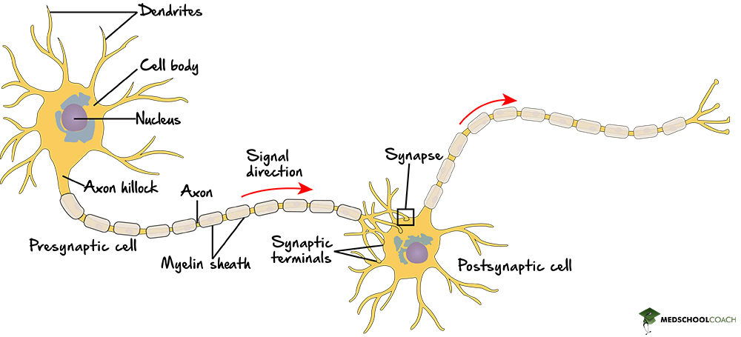
🧠 The McCulloch-Pitts Neuron (1943)
The foundational idea: a brain cell is just a logic gate. If it gets enough electrical signals at once, it fires. Otherwise, it stays silent. McCulloch and Pitts asked — can we write that as math?
Warren McCulloch (neurophysiologist) and Walter Pitts (logician) published "A Logical Calculus of Ideas Immanent in Nervous Activity" — the first mathematical model of how neurons fire. They showed that neural networks could, in principle, compute any logical function. This gave scientists a blueprint: the brain is computable.

Slide 3
📐 The Mathematical Model
The MP neuron is the simplest possible mathematical abstraction of a biological neuron. It has three parts:
1. Binary Inputs — each input xᵢ is either 0 (off) or 1 (on), just like a nerve impulse either arrives or doesn't.
2. Weights — each input has an associated weight wᵢ. In the original paper these were all 1, but the weight can be negative to model inhibitory synapses (signals that prevent firing).
3. Threshold activation — the neuron computes the weighted sum and compares it to a threshold θ:
output = 1 if Σ(wᵢ · xᵢ) ≥ θ
output = 0 if Σ(wᵢ · xᵢ) < θ
That's it. No learning, no gradients, no probabilities — just a sum and a hard cutoff.

Slide 4
⚙️ Implementing Logic Gates
The power of this model was that it could compute any Boolean logic function by choosing the right weights and threshold.
Gate | Inputs | Weights | Threshold θ | How it works
AND | x1, x2 | 1, 1 | 2 | Both must fire → sum=2 ≥ 2 ✓
OR | x1, x2 | 1, 1 | 1 | Either fires → sum≥1 ✓
NOT | x1 | −1 | 0 | Input off → sum=0 ≥ 0 fires; input on → sum=−1 < 0 silent
NOR | x1, x2 | −1, −1 | 0 | Only fires if both inputs are 0

Slide 5
🔬 Biological Analogy
Biology | McCulloch-Pitts Model
Dendrites receiving signals | Inputs x1, x2, ... xn
Synaptic strength | Weights wᵢ
Inhibitory synapse | Negative weight wᵢ < 0
Axon hillock summation | Σ(wᵢ · xᵢ)
Action potential threshold | Threshold θ
Neuron fires / doesn't fire | Output = 1 or = 0

Slide 6
📐 The Notation System
Nᵢ(t) = neuron i fires at time t (1 = fires, 0 = silent)
.=. = "if and only if" / logical equivalence
.v. = OR
. (dot) = AND
- = NOT (inhibition)
(Ex) = "there exists an x such that..." (existential quantifier)
t-1, t-2 = synaptic delay — signal takes 1 or more time steps to arrive
Eg- N₁(t) .=. N₁(t−1)
N₁ fires at time t IF N₁ fired at time t−1
→ Self-excitation / memory. The neuron keeps itself active once triggered. Models a persistent firing loop — the simplest form of neural memory.
Eg - N₂(t) .=. N₁(t−1) ∨ N₃(t−1)
N₂ fires IF N₁ fired OR N₃ fired (one step ago)
→ OR gate. Any one excitatory input is sufficient to trigger the neuron. This is the biological equivalent of convergent excitation — multiple pathways activating the same cell.

Slide 7
Eg- N₃(t) .=. N₁(t−1) ∧ N₂(t−1)
N₃ fires IF N₁ fired AND N₂ fired (one step ago)
→ AND gate. Both inputs must arrive simultaneously. Models coincidence detection — a fundamental operation in sensory processing (e.g. detecting two features co-occurring).
⚠️ Critical Limitations
The MP neuron was revolutionary but had major constraints that defined the next 80 years of AI research:
No learning — weights and threshold are set by hand. The neuron cannot adjust itself from experience. This was the core problem Frank Rosenblatt solved 15 years later with the Perceptron.
Binary only — inputs and outputs are strictly 0 or 1. No continuous values, no probabilities, no uncertainty.
No XOR — a single MP neuron cannot compute XOR (exclusive or), because XOR is not linearly separable. This limitation — later formalized by Minsky & Papert in 1969 — killed neural network research for a decade.
No time — the model is stateless. There is no memory of past activations, no recurrence.

Slide 8
Alan Turing's "Computing Machinery and Intelligence" — 1950
Turing asked the now-legendary question: "Can machines think?" He proposed the Imitation Game (the Turing Test) — if a machine could converse indistinguishably from a human, it could be considered intelligent. This paper framed the philosophical debate that still continues today.
The Imitation Game
Turing's original setup had 3 participants:
Participant | Role
Interrogator (C) | A human judge in a separate room, communicating only via text
Human (B) | A human in another room, trying to help the judge identify them correctly
Machine (A) | A computer, trying to convince the judge it is the human
All communication is through a teletype (typewritten text) — removing voice, appearance, and all physical cues. The interrogator asks any questions they like. If the interrogator cannot reliably distinguish the machine from the human, the machine is said to have passed.

Slide 9
🏆 Has Any AI Passed It?
Eugene Goostman (2014) — A chatbot posing as a 13-year-old Ukrainian boy reportedly convinced 33% of judges at a University of Reading competition. Widely disputed — the persona gave the chatbot a huge excuse for odd answers.
Large Language Models (2020s) — GPT-4, Claude, and similar models routinely fool people in text conversations. In informal settings, the Turing Test is essentially "solved" for short interactions. But researchers argue this reveals the test's inadequacy, not machine consciousness.
🤖 ELIZA — The World's First Chatbot (1966)
ELIZA is extraordinarily simple by modern standards. It contains no knowledge, no understanding, no model of the world — only a pattern-matching engine operating on text.
YOU: I feel sad
ELIZA: Why do you feel sad?
YOU: My brother is annoying
ELIZA: Tell me more about your brother.
YOU: I am tired
ELIZA: How long have you been tired?
Pattern: "I am (.*)"
Response: "Why do you say you are [captured group]?"
Input: "I am feeling hopeless"
Captured: "feeling hopeless"
Output: "Why do you say you are feeling hopeless?"

Slide 10
🏫 The 1956 Dartmouth Conference
Summer of 1956 — roughly 6–8 weeks — at Dartmouth College, Hanover, New Hampshire. Organised by four researchers who submitted a proposal to the Rockefeller Foundation requesting funding for a two-month study. The proposal contained the first ever formal use of the phrase "artificial intelligence"
Before it, scattered researchers worked in isolation. After it, artificial intelligence existed as a named, funded, organised field.
Person | Affiliation | Legacy
John McCarthy | Dartmouth College | Coined "AI", invented LISP, Turing Award 1971
Marvin Minsky | Harvard | MIT AI Lab co-founder, Turing Award 1969
Claude Shannon | Bell Labs | Father of information theory
Nathaniel Rochester | IBM | Designed the IBM 701 computer

Slide 11
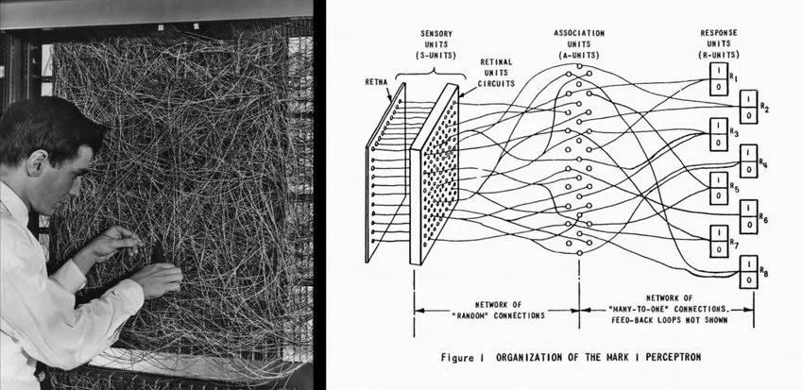
The Perceptron (1957–1958)
The Perceptron was the first machine that could genuinely learn from experience — not just execute a program, but adjust its own internal parameters based on examples. This was a conceptual earthquake. It meant intelligence wasn't something you had to hand-code; it could emerge from training.
Frank Rosenblatt
Frank Rosenblatt was a Cornell University psychologist and computer scientist. He was fascinated not by formal logic or theorem-proving — the dominant AI paradigm post-Dartmouth — but by the brain itself. His approach was explicitly biological: build something that learns the way neurons learn.
In 1957–1958 he designed and implemented the Perceptron, first as a software simulation and then as Mark I — a custom-built hardware machine at Cornell Aeronautical Laboratory, funded by the US Navy. It had 400 photocells as inputs and could learn to recognize visual patterns.

Slide 12
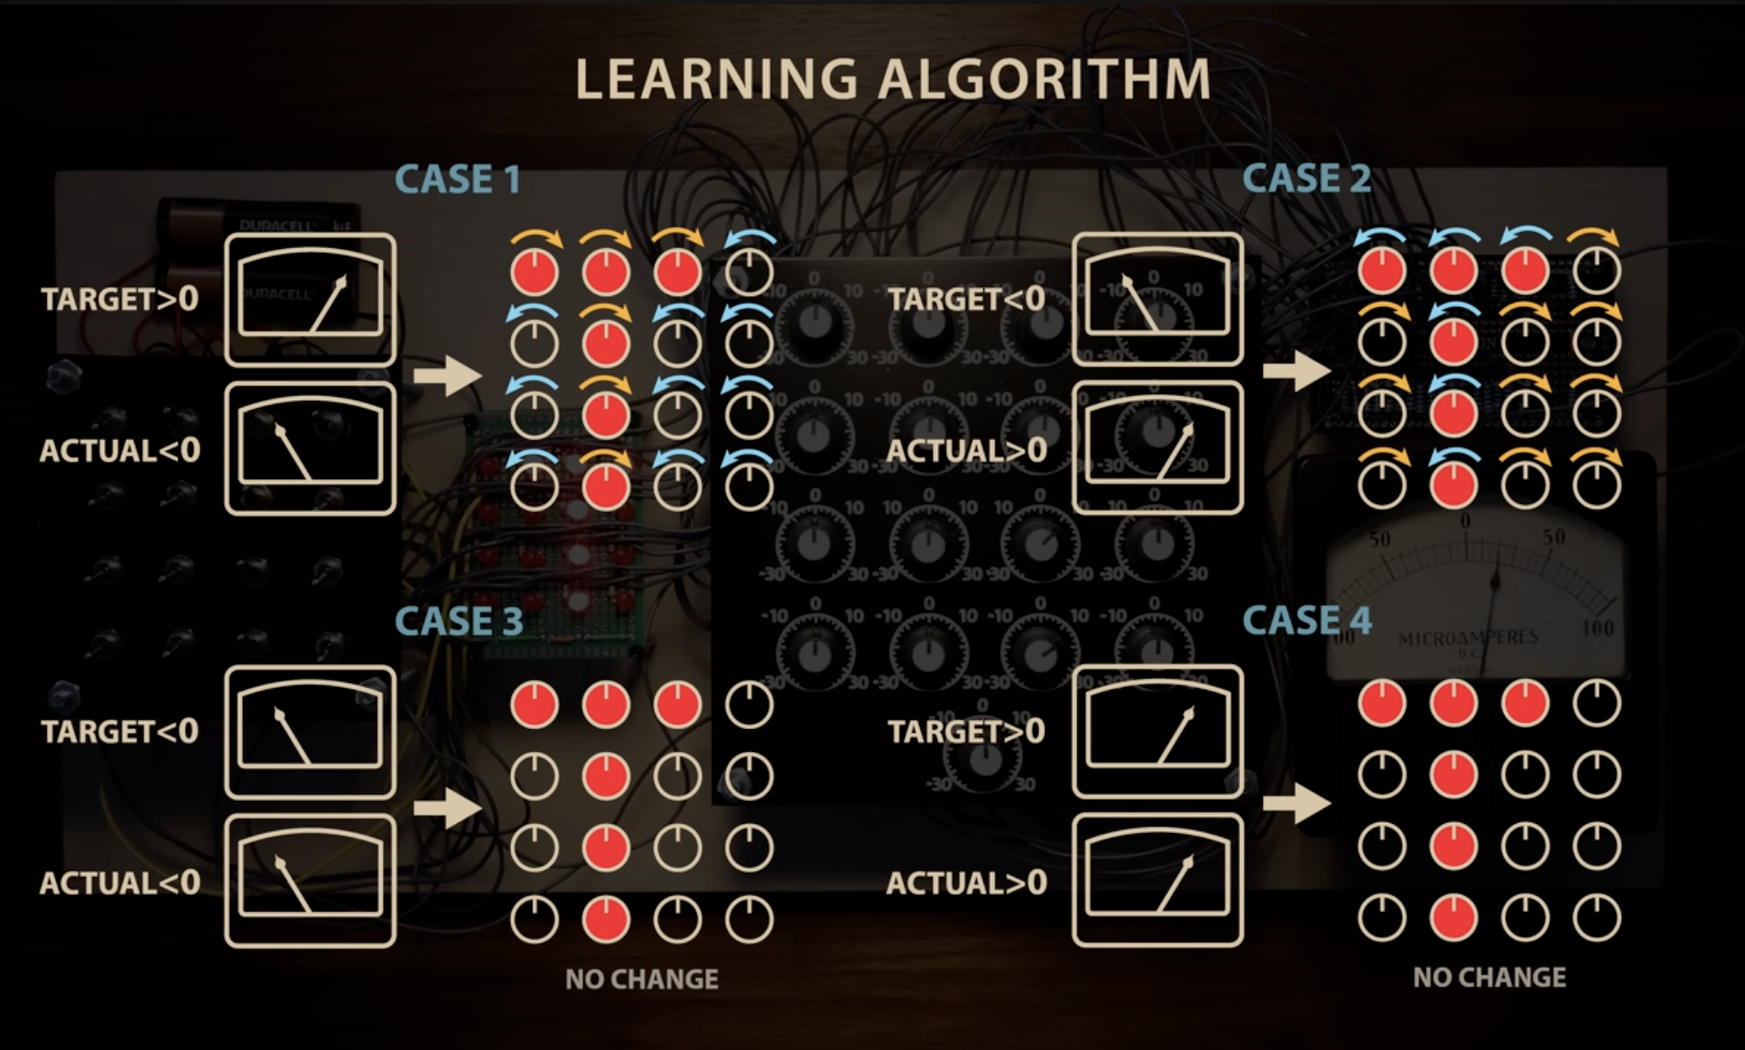

Slide 13
Backpropagation
Backpropagation is the algorithm that made deep learning possible. It solves the fundamental problem of multi-layer networks: given that the output is wrong, which weights are to blame, and by how much? The answer comes from calculus — specifically, the chain rule applied in reverse through the network.
1960 | Henry Kelley / Arthur Bryson | Backprop-like ideas in optimal control theory
1970 | Seppo Linnainmaa | Published automatic differentiation — the mathematical core — in his Master's thesis
1974 | Paul Werbos | Described backprop for neural networks in his Harvard PhD thesis — largely ignored
1982 | David Parker | Rediscovered it independently
1986 | Rumelhart, Hinton & Williams | Published "Learning Representations by Back-propagating Errors" in Nature — the paper that changed everything

Slide 14
The fundamental problem backprop solves is called the credit assignment problem: in a network with millions of weights and a single scalar loss, how do you know which weight caused the error?
The answer is calculus. Every weight's contribution to the loss can be computed exactly using the chain rule:
∂L/∂w = ∂L/∂a_out × ∂a_out/∂z_out × ∂z_out/∂w
Step 1: Forward Pass
Compute activations layer by layer, left to right. Store every intermediate value — you'll need them for the backward pass.
Step 2: Compute Output Gradient
How does the loss change with respect to the output?
Step 3: Propagate Backward — Chain Rule
Work right to left. At each layer, multiply the incoming gradient by the local derivative
Step 4: Update Weights — Gradient Descent
Nudge every weight in the direction that reduces loss

Slide 15
Rule Based Expert Systems Boom
DENDRAL (1965–80) — determined molecular structures from mass spectrometry data. Used for 15 years in real labs — the first proof expert systems could work outside academia.
MYCIN (1972) — diagnosed bacterial infections using 600 IF-THEN rules with certainty factors. Outperformed junior doctors (65% correct vs 42–62%). Never deployed due to liability concerns — the first AI ethics debate.
XCON / R1 (1980) — configured VAX computer orders for DEC using 2,500 rules. Saved $40 million per year. Triggered a global expert systems gold rush — billions invested, hundreds of commercial deployments.
Deep Blue (1997) - Deep Blue was IBM's chess-playing computer that defeated world champion Garry Kasparov in May 1997 — the first time a machine beat a reigning world champion in a classical chess match. Not neural networks, not learning — pure brute-force search with hand-crafted evaluation.
The AlphaZero verdict (2017): DeepMind's AlphaZero learned chess from scratch with no rules except legal moves, via pure self-play reinforcement learning, in 4 hours — then defeated the strongest rule-based successor to Deep Blue convincingly. What took IBM years of knowledge engineering, AlphaZero learned from data alone.
Four fatal flaws destroyed the expert systems industry simultaneously:
Brittleness — systems performed perfectly within their domain and catastrophically outside it. Real problems don't stay in domains.
Knowledge acquisition bottleneck — extracting rules from human experts was slow, expensive, and often impossible. Experts couldn't articulate their own tacit knowledge.
Maintenance nightmare — 2,500 rules interact in unpredictable ways. Fixing one rule broke five others. XCON needed a full-time team just to keep it running.
No learning — every piece of knowledge had to be manually encoded. Systems couldn't improve from experience or adapt to new situations.

Slide 16
AI Renaissance
1. Data Explosion (Internet Effect)
The internet unintentionally created the largest training dataset in history:
Text (1990s): Massive web pages enabled early NLP and search engines like Google.
Images (2000s): Platforms like Flickr and Facebook generated billions of labeled images.
ImageNet (2009): Built by Fei-Fei Li, it became the key benchmark that triggered deep learning progress.
Behavioral Data: Clicks, searches, and purchases (Google, Amazon, Netflix) became training signals.
Result: ML moved from data scarcity → data abundance
⚙️
2. Compute Revolution
Training large models became feasible due to:
Moore’s Law: Exponential CPU improvements
GPUs + CUDA: Parallel computation made neural networks practical (via NVIDIA)
Cloud Computing: Amazon Web Services and others made compute accessible
Result: Training went from weeks → days → hours

Slide 17
3. Algorithm Advances
Key improvements made learning actually work:
SVMs: Dominated pre-2012 ML
Deep Belief Networks (2006): Led by Geoffrey Hinton, solved training issues in deep nets
CNNs: Introduced by Yann LeCun, became practical with GPUs
Result: Deep learning became trainable and scalable
4. The Turning Point — AlexNet (2012)
Built by Alex Krizhevsky, Ilya Sutskever, and Hinton:
Crushed previous benchmarks on ImageNet
Used GPUs + deep CNNs
Marked the start of the deep learning era
🔗 What It Led To
AlexNet (2012) → GANs (2014) → ResNet (2015) → Transformer (2017) → BERT/GPT-1 (2018) → GPT-3 (2020) → ChatGPT (2022). The throughline is unbroken — internet data, GPU compute, and revived algorithms all converging at ImageNet was the starting gun for modern AI.

